Slide 1
STAT 430 Final Project
Characterizing Soccer Players’ Playing Styles using Non-Negative Matrix Factorization
Lucas Nelson | May 12th, 2022

Slide 2
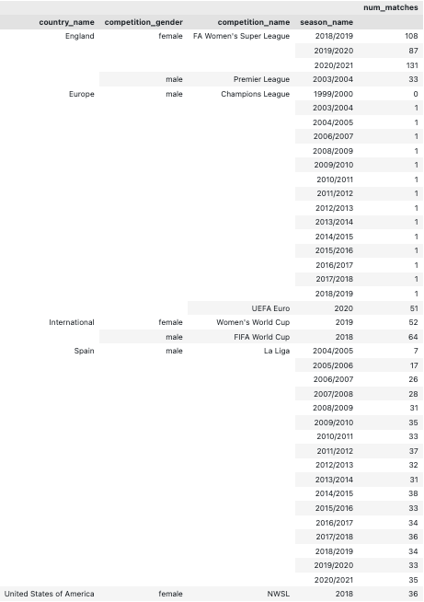
Project Outline
Motivation
Can we vectorize a soccer player’s playing style?
Applications
Player comparison, scouting uprising talent, evaluating player wages
Procedure
Gather event-stream data
Statsbomb OpenAccess database
Details every on-ball action performed per match
Extract offensive-oriented actions from event stream data
Action types: shots, passes, dribbles, crosses
Attributes:
pitch coordinates (x, y pitch coordinates for location and end location)
outcome (success, failure)
probability of success (expected goal)
Design and compare player vectors
Assess clusterability per action type
Scale frequency data by minutes played
Non-negative matrix factorization (NMF)

Slide 3
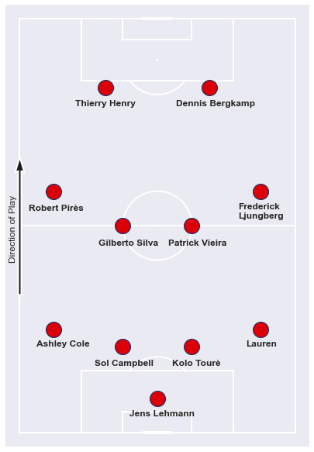
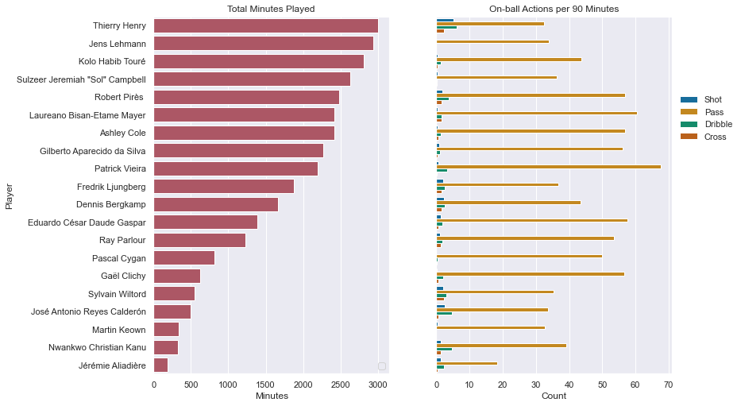
Arsenal 2003/04 – ‘The Invincibles’
Based on Arsenal’s lineup and each player’s actions per match (90 minutes), a player’s position and time on the pitch influences which actions they commit and how often they commit them.

Slide 4
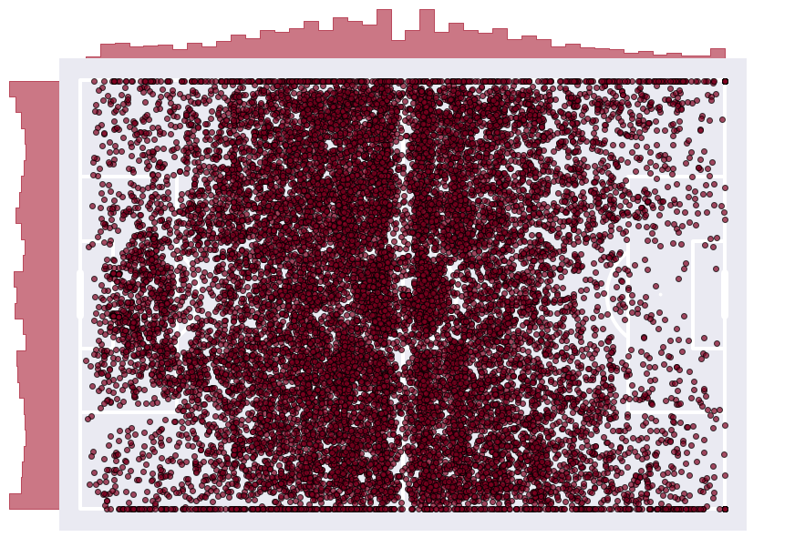
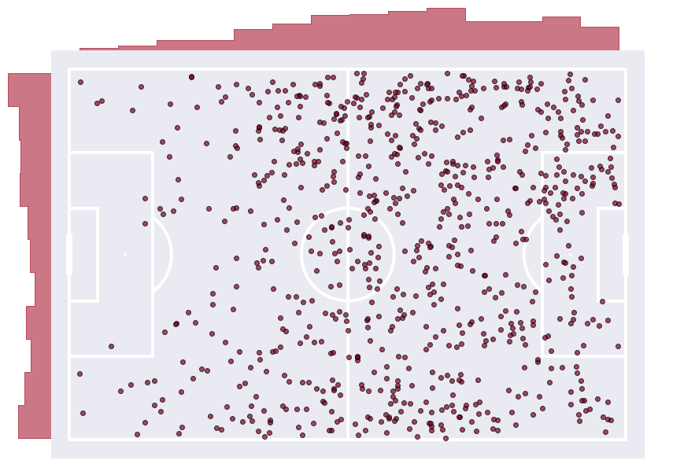
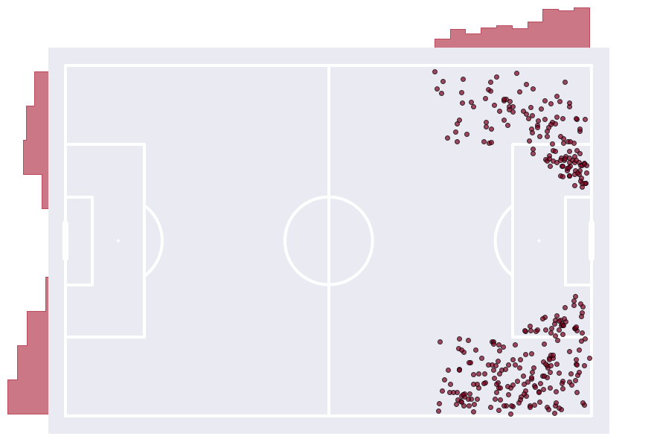
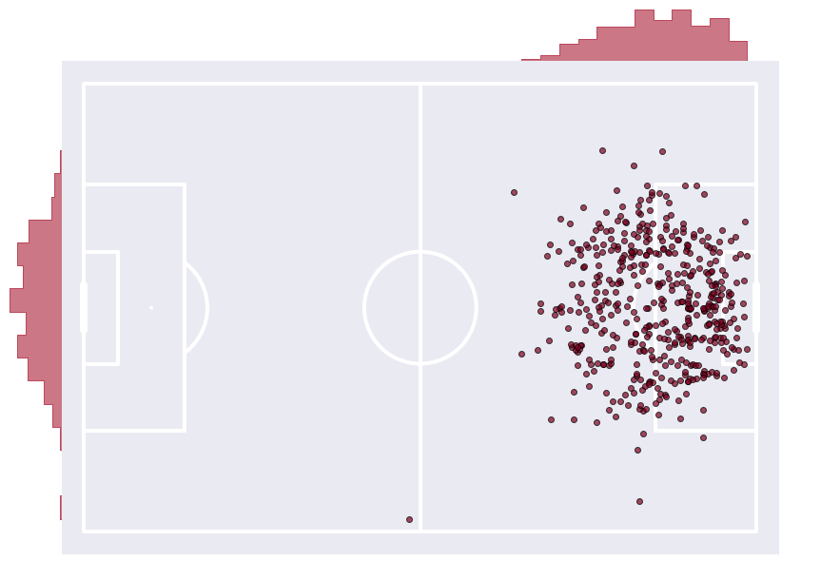
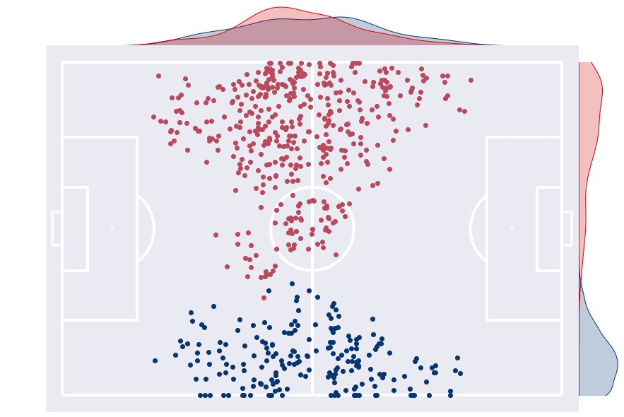
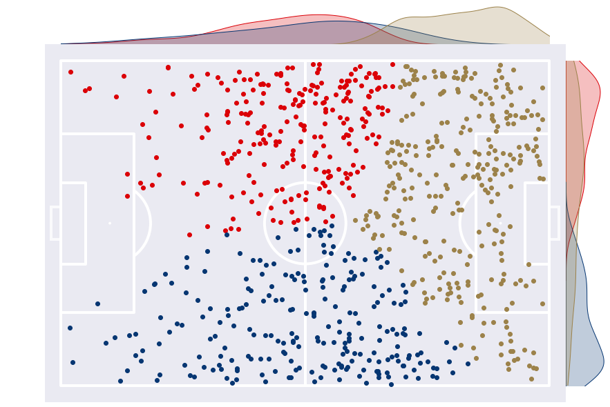
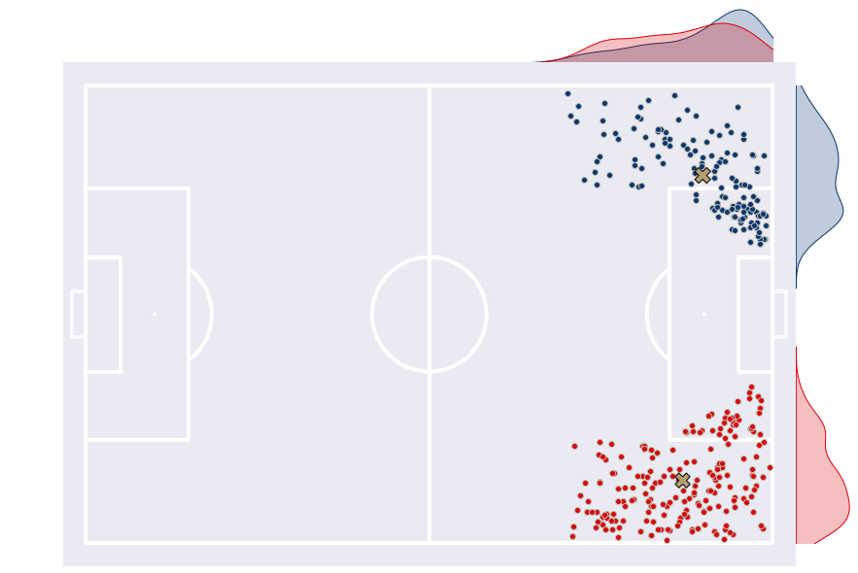
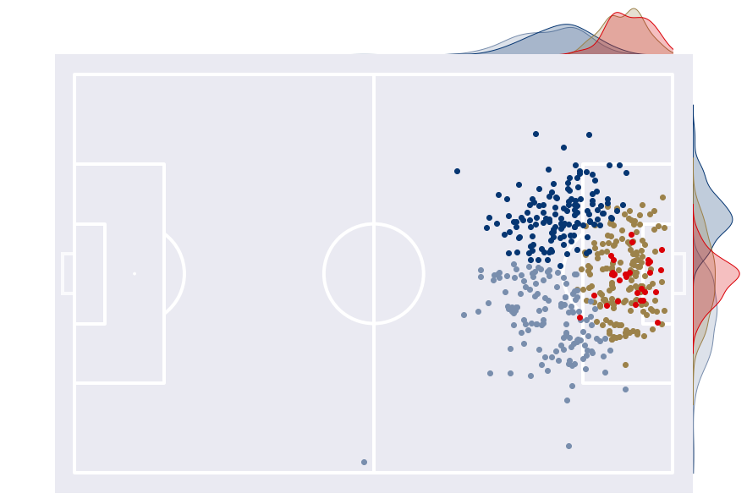
Determining clustering structure per action type
Pass
Dribble
Cross
Shot
DBSCAN(eps=7.5, mnpts=4)
KMeans(n_clusters=3)
KMeans(n_clusters=2)
KMeans(n_clusters=4)
The clusterability of each action type is dependent on the location of the pitch and how often – as well as to what quality – the action is performed at said location on the pitch

Slide 5
Non-Negative Matrix Factorization (NMF)

Slide 6
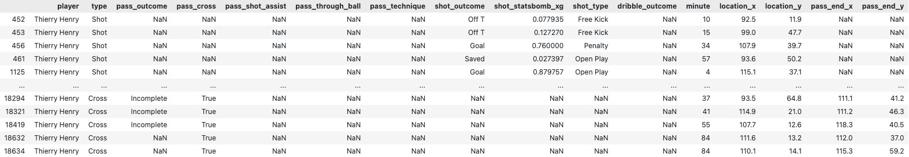
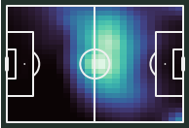
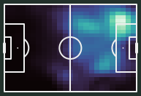
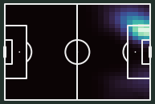
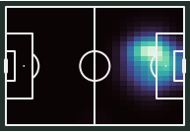
Converting event-stream data into player heatmaps allows us to cluster pitch grids and player actions
Pass
Dribble
Cross
Shot
Heatmaps effectively convey a player’s rating preferences of pitch grids per action type which will assist us in determining the number of clusters per action type in non-negative matrix factorization.

Slide 7
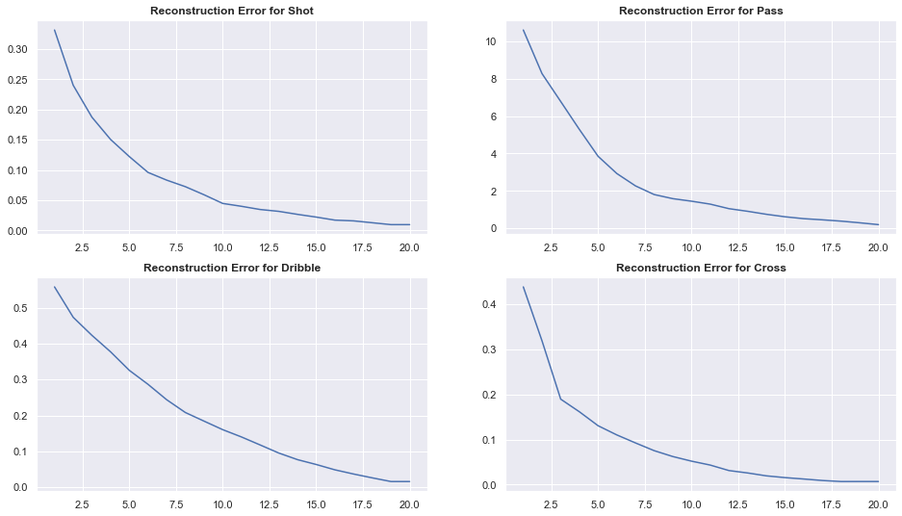
NMF allows us to simultaneously cluster the grids on the pitch and each players’ action frequencies
Number of components
Shot: 6
Cross: 3
Pass: 5
Dribble: 5
Observations: pitch grids
24 columns
25 rows
Attributes: players
600 entries
Frequency of action type in specific pitch grid
Finding the elbow in the reconstruction error elbow plots, we can determine the appropriate number of clusters – or components – per action type

Slide 8
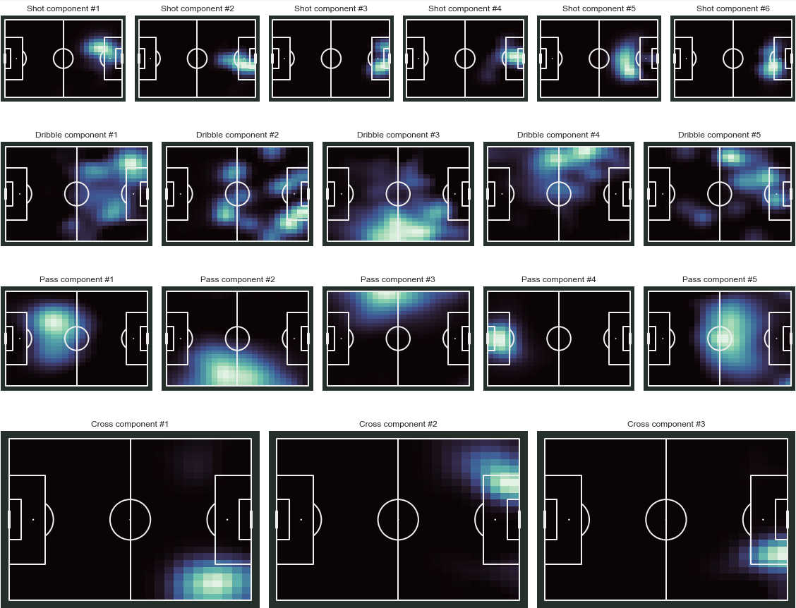
NMF Results: Component Clusters
Shots
Dribbles
Passes
Crosses

Slide 9
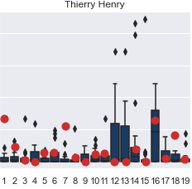
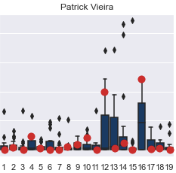
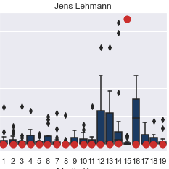
Player Results: Component Distributions
Attacking style player
Passing style player
Non-attacking style player
Viewing players’ component distribution allows us to assess which of the nineteen components their playing style most relies on, allowing club staff to make informed decisions and comparisons.

Slide 10
Conclusion

